Slide 1



THE
HISTORY
OF
DRAMA

Slide 2
▪
The term Drama comes from a Greek word
meaning "action" (Classical Greek: δρᾶμα, drama), which is derived from the verb meaning "to do" or "to act" (Classical Greek: δράω, draō).

Slide 3

▪
The two famous
drama masks represent the division between
Comedy and tragedy.
They are symbols of ancient Greek Muses, Thalia and Melpomene.
Thalia was the Muse of comedy, while Melpomene was the Muse of tragedy.
masks of
comedy
the
Melpomene.
of
▪
▪

Slide 4
▪
At first, and after Aristotle's Poetics (the earliest
work of dramatic theory), drama was considered
as a genre of poetry, and was contrasted with
the epic and the lyrics.
The use of "drama" in the narrow sense to
designate a specific type of play dates from the
19th century.
Drama in this sense refers to a play that is neither a comedy nor a tragedy—for example, Ibsen’s A Doll’s House.
▪
▪

Slide 5
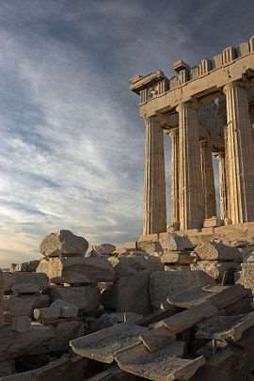
History
of
Western
Drama
▪
Western drama
originates in classical
Greece.

Slide 6
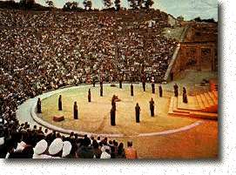
▪
The theatrical culture of the city-state of Athens
produced three genres of drama: tragedy,
comedy, and the satyr play.
The origins of drama go back to competitions held as part of festivities celebrating the god Dionysus.
▪

Slide 7
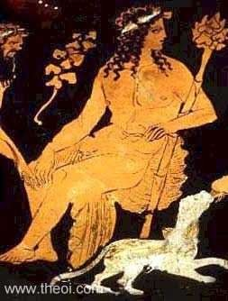
▪
Great Dionysia,
also called City
Dionysia , ancient
dramatic festival in
which tragedy,
comedy, and satyric
drama originated; it
was held in Athens
in March in honour
of Dionysus, the
god of wine.

Slide 8
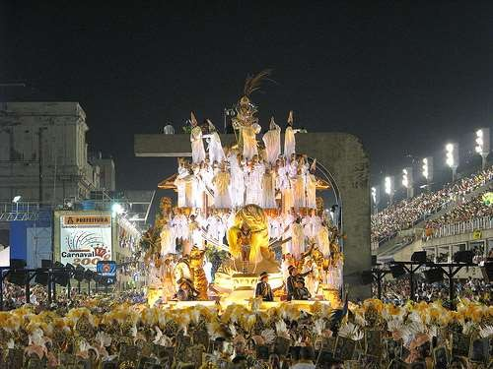

Slide 9
Ritual
&
Drama:
Differences
▪
In the ancient world, ritual usually required
animal sacrifice; in tragic drama, the hero is
sacrificed onstage.
Rituals do not involve us by way of identification with a character, as plays do, and they do not depend on surprise or suspense.
▪

Slide 10
▪
It is perhaps because ancient Greek religion
strongly emphasized the power of the gods to
surprise us, to intervene in our lives and
sometimes overturn them, that drama became a
chosen form for the honoring of the divine.

Slide 11
Significant
Greek
Dramatists
▪
Only a small fraction of the work of five
dramatists has survived to this day:
the tragedians: Aeschylus, Sophocles and
Euripides,
and the comic writers Aristophanes and, from
the late 4th century, Menander
▪
▪

Slide 12
Chorus
▪
Among the ancient Greeks the chorus was a
group of people, wearing masks, who sang or
chanted verses while performing dancelike
movements at religious festivals.

Slide 13
Chorus
▪
A similar chorus played a part in Greek
tragedies, where (in the plays of Aeschylus
and Sophocles) they served mainly as
commentators on the dramatic actions and
events that express traditional, moral,
religious, and social attitudes; beginning with
Euripides, however, the chorus assumed
primarily a lyrical function.

Slide 14
Satyr
play
▪
Satyr plays were an ancient Greek form of
tragicomedy, similar in spirit to the
burlesque. The featured choruses of satyrs,
were based on Greek mythology, and were
rife with mock drunkenness, brazen sexuality,
and general merriment

Slide 15
Roman
drama
▪
Following the expansion of the Roman Republic
(509–27 BCE) into several Greek territories
between 270–240 BCE, Rome encountered
Greek drama.

Slide 16
▪
In re-working the Greek originals, the Roman
comic dramatists abolished the role of the
chorus in dividing the drama into episodes
and introduced musical accompaniment to its
dialogue (between one-third of the dialogue
in the comedies of Plautus and two-thirds in
those of Terence).

Slide 17
Medieval
Drama
▪
Medieval drama, when it emerged hundreds of
years after the original tragedies and comedies,
was a new creation rather than a rebirth, the
drama of earlier times having had almost no
influence on it.

Slide 18
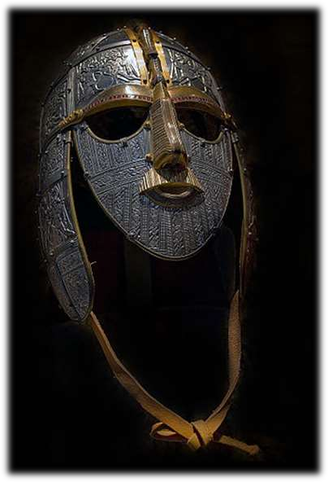
Middle
Ages
▪
The Middle Ages is a period
of European history that
lasted from the 5th until the
15th centuries. It began with
the collapse of the Western
Roman Empire, and was
followed by
the Renaissance and the Age
of Discovery.

Slide 19
▪
The Middle Ages is the middle period of the
traditional division of Western history into
Classical, Medieval, and Modern periods. The
period is subdivided into the Early Middle
Ages, the High Middle Ages, and the Late
Middle Ages.

Slide 20
Medieval
Drama
▪
The Christian church had traditionally opposed
any form of theater. But little by little, in the
Easter service, and later in the Christmas service,
bits of chanted dialogue, called tropes, were
interpolated into the liturgy. Priests,
impersonating biblical figures, acted out
minuscule scenes from the holiday stories.

Slide 21
Medieval Drama
▪
Eventually, these plays grew more elaborate and
moved out of the church. Secular elements crept
in as the artisan guilds took responsibility for
these performances; although the glorification
of God and the redemption of humanity
remained prime concerns, the celebration of
local industry was not neglected.

Slide 22
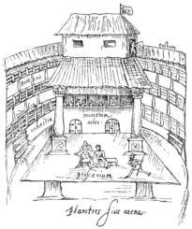
Renaissance
(Elizabethan)
Drama
▪
The Renaissance saw a
huge resurgence in all
types of art, including
theater. It was during this
time that Commedia
Dell'arte flourished and
the first Elizabethan
playhouse opened.

Slide 23
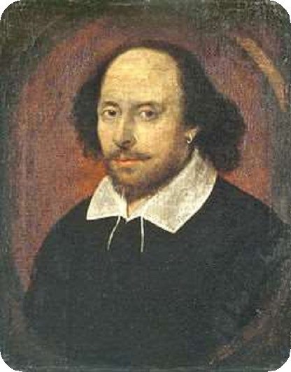

▪
William Shakespeare,
one of the
renowned
wrote and
world's most
playwrights,
produced
many plays that are still
performed regularly
even today.

Slide 24
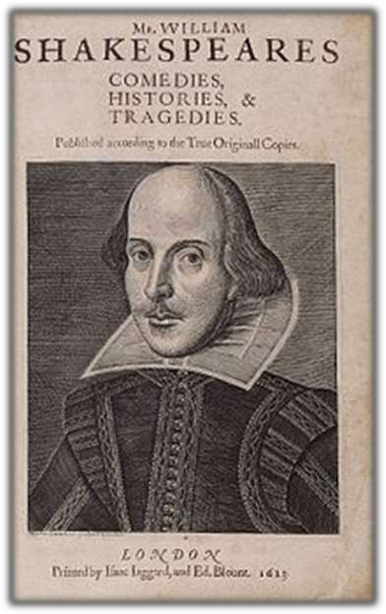
▪
Shakespeare was one of
the first to weave comic
elements into tragedies.
He also developed a
structure and several
types of characters that
are still common in
modern drama.

Slide 25
The
18th
Century
Drama
▪
The 18th century was a time when more plays
were being written for and about the middle class.
At first the theaters relied on the pre-Civil War repertoire; before long, however, they felt called upon to bring these plays into line with their more "refined," French-influenced sensibilities.
▪

Slide 26
The
18th
Century
Drama
▪
The themes, language, and dramaturgy of
Shakespeare's plays were now considered out
of date, so that during the next two centuries
the works of England's greatest dramatist
were never produced intact. Owing much to
Moliere, the English comedy of manners was
typically a witty, brittle satire of current
mores, especially of relations between the
sexes.

Slide 27
19th
Century
Drama
and Romanticism
▪
Toward the end of the century, the Romantic
period began in Western Europe, which heavily
influenced the theater of that era. Romanticism
focused on emotion rather than intellect. This
movement continued through the beginning of
the 19th century.

Slide 28
▪
In its purest form, Romanticism concentrated on
the spiritual, which would allow humankind to
transcend the limitations of the physical world
and body and find an ideal truth.
Subject matter was drawn from nature and "natural man" (such as the supposedly untouched Native American). Perhaps one of the best examples of Romantic drama is Faust (Part I,
1808; Part II, 1832) by the German playwright
Johann Wolfgang von Goethe.
▪

Slide 29
▪
Romanticism first appeared in Germany, a
country with little native theatre other than
rustic farces before the 18th century. By the
1820s Romanticism dominated the theatre
most of Europe.
of
▪
These plays had no single style but were
generally strongly emotional, and, in their
experimentation with form, laid the groundwork
for the rejection of Neo-Classicism.

Slide 30
Modern
Drama
▪
Romanticism gave way to Realism during the
19th century, paving the way for the era of
contemporary drama in the 20th century.
Contemporary drama shows the influence of all
that has come before.

Slide 31
Modern
Drama
▪
Modern drama involved much
experimentation with new forms and ideas. In
the early part of the 20th century, musical
drama came to dominate stages in NewYork
and England, although each theater season
saw the release of straight dramatic plays as
well.

Slide 32
Modern
Drama
▪
Many movements generally lumped together as
the avant-garde, attempted to suggest
alternatives to the realistic drama and production.
The various theoreticians felt that Naturalism
presented only superficial and thus limited or
surface reality-that a greater truth or reality could
be found in the spiritual or the unconscious.

Slide 33
▪
Others felt that theatre had lost touch with its
origins and had no meaning for modern society
other than
Paralleling
to symbol,
as a form of entertainment.
modern art movements, they turned
abstraction, and ritual in an attempt
to revitalize the theatre. Although realism
continues to be dominant in contemporary
theatre, television and film now better serve its
earlier functions.

Slide 34
Symbolist
drama
▪
The Symbolist movement in France in the 1880s
affected the theater. The movement called for
"de-theatricalizing" the theatre, meaning
stripping away all the technological and scenic
encumbrances of the 19th century and replacing
them with a spirituality that was to come from
the text and the acting.

Slide 35
Symbolist
drama
▪
The texts were laden with symbolic imagery not
easily construed-rather they were suggestive. The
general mood of the plays was slow and dream-
like. The intention was to evoke an unconscious
response rather than an intellectual one and to
depict the nonrational aspects of characters and
events.

Slide 36
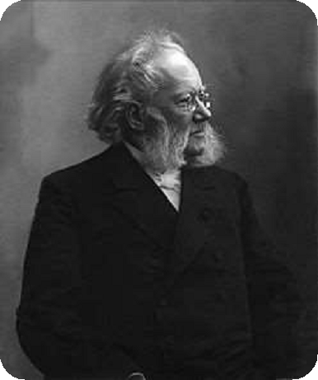
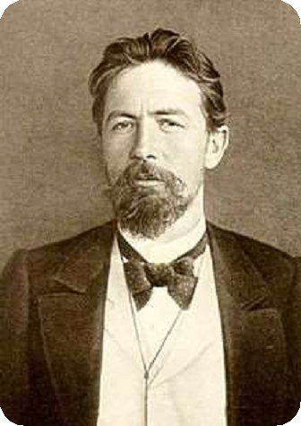
▪
Strong Symbolist elements can be found in the
plays of Chekhov and the late works of Ibsen and
Strindberg.

Slide 37
▪
Symbolist influences are also evident in the
works of such later playwrights as the Americans
Eugene O'Neill and Tennessee Williams and the
Englishman Harold Pinter, propounder of
"theatre of silence".

Slide 38
Expressionist
drama
The Expressionist movement was popular in the
1910s and 1920s, largely in Germany. It explored
the more violent, grotesque aspects of the
human psyche, creating a nightmare world
onstage. Distortion and exaggeration and a
suggestive use of light and shadow typify
Expressionism.

Slide 39
▪
Stock types replaced individualized
characters or allegorical figures, much as in
the morality plays, and plots often revolved
around the salvation of humankind.

Slide 40
Contemporary
drama
▪
Many playwrights of the 1960s and 1970s-Sam
Shepard in the United States, Tom Stoppard in
England-built plays around language: language as
a game, language as sound, language as a barrier,
language as a reflection of society. In their plays,
dialogue frequently cannot be read simply as a
rational exchange of information. Many
playwrights also mirrored society's frustration with
a seemingly uncontrollable, self-destructive world.

Slide 41
▪
In Europe in the 1970s, new playwriting was
largely overshadowed by theatricalist
productions, which generally took classical
plays and reinterpreted them, often in bold
new scenographic spectacles, expressing
ideas more through action and the use of
space than through language.

